Slide 1




RESTAURANT RATING PREDICTION USING ML
By-Manav Shah

Slide 2


TABLE OF CONTENTS
01
02
03
04
05
06
PROBLEM
STATEMENT
DATASET
OVERVIEW
IMPORTING
DATA
DATA PREPROCESSING
MODEL IMPLEMENTATION
CONCLUSION

Slide 3
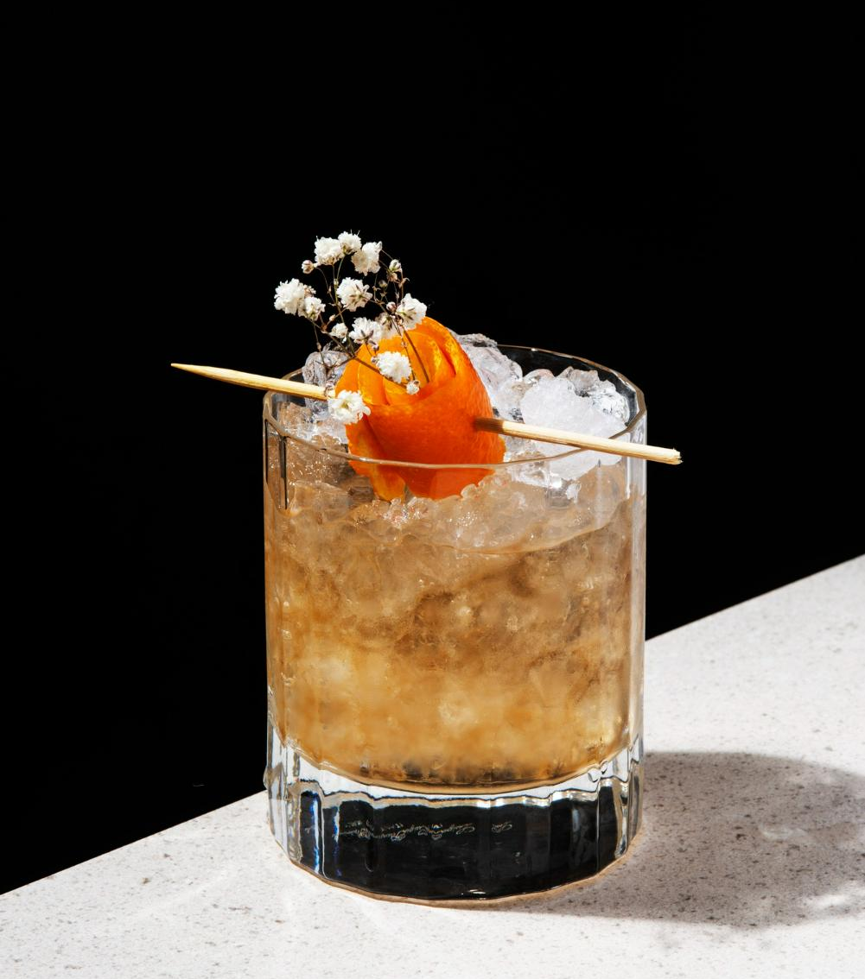


01
PROBLEM STATEMENT

Slide 4


PROBLEM STATEMENT
Develop a machine learning model to predict the aggregate rating of a restaurant based on various features related to the restaurant's characteristics and operations.
OBJECTIVE
Predicting Restaurant Ratings

Slide 5
02
DATASET OVERVIEW

Slide 6
DATASET OVERVIEW
The dataset contains the following columns:
1. Restaurant ID: Unique identifier for each restaurant.
2. Restaurant Name: Name of the restaurant.
3. Country Code: Numeric code representing the country where the restaurant is located.
4. City: Name of the city where the restaurant is situated.
5. Address: Physical address of the restaurant.
6. Locality: Locality or neighborhood where the restaurant is located.
7. Locality Verbose: Detailed description of the locality.
8. Longitude: Geographical longitude of the restaurant's location.
9. Latitude: Geographical latitude of the restaurant's location.
10. Cuisines: Types of cuisines offered by the restaurant.
11. Average Cost for Two: Average cost for a meal for two people.
12. Currency: Currency used for transactions in the restaurant.

Slide 7
DATASET OVERVIEW
13. Has Table Booking: Indicator of whether the restaurant accepts table bookings.
14. Has Online Delivery: Indicator of whether the restaurant offers online delivery.
15. Is Delivering Now: Indicator of whether the restaurant is currently delivering.
16. Switch to Order Menu: Indicator of whether the restaurant has switched to an order menu.
17. Price Range: Price range category of the restaurant.
18. Aggregate Rating: Overall rating of the restaurant.
19. Rating Color: Color code representing the rating.
20. Rating Text: Text description of the rating.
21. Votes: Number of votes received by the restaurant.

Slide 8
03
IMPORTING DATA

Slide 9
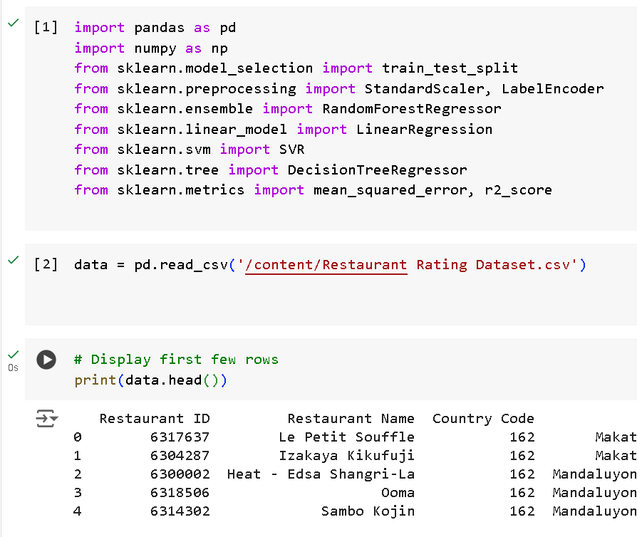



Slide 10
04
DATA PREPROCESSING

Slide 11
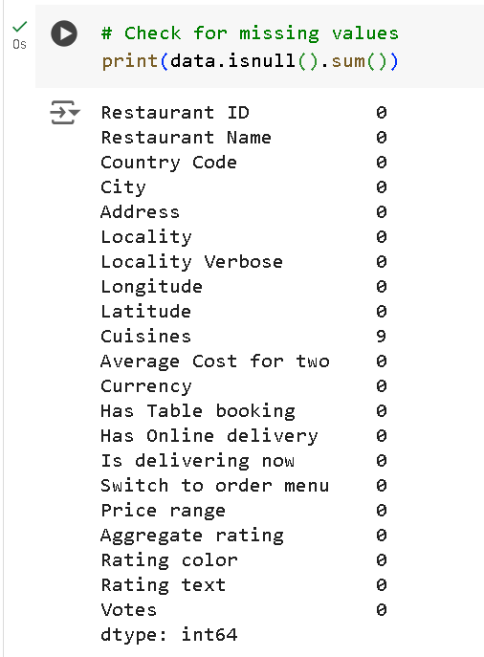
CHECKING FOR NULL VALUES AND HANDELLING :

Slide 12
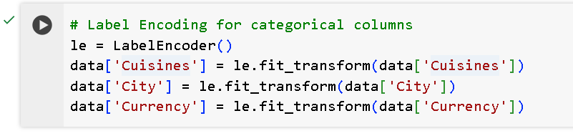
LABEL ENCODING FOR CATEGORICAL COLUMNS

Slide 13
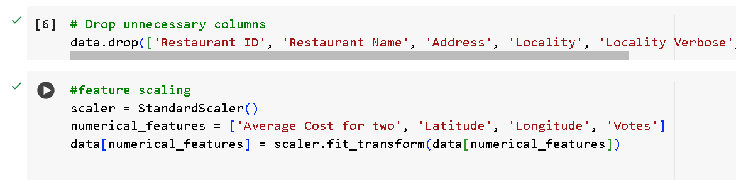
REMOVING UNNECESSARY COLUMNS AND FEATURE SCALING

Slide 14
05
MODEL IMPLEMENTATION

Slide 15
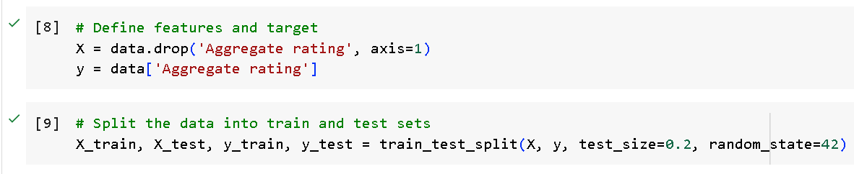
DEFINING FEATURES AND TARGETS AND SPLIT INTO TRAIN TEST DATA

Slide 16
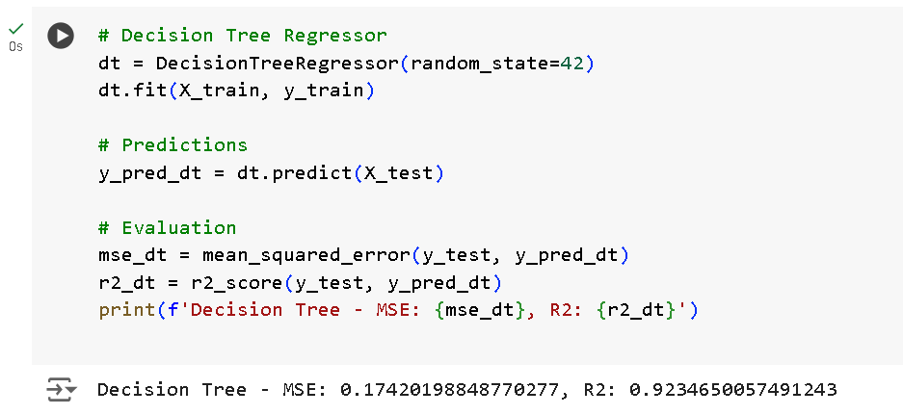
IMPLEMENTING DECISION TREE REGRESSOR

Slide 17
IMPLEMENTING RANDOM FOREST REGRESSOR

Slide 18
06
CONCLUSION

Slide 19
CONCLUSION
The Random Forest Regressor outperforms the Decision Tree Regressor in both metrics:
The MSE is lower for the Random Forest Regressor (0.0875 vs. 0.1742), indicating that the model's predictions are, on average, closer to the actual values.
The R² score is higher for the Random Forest Regressor (0.9616 vs. 0.9235), which means that it explains a larger proportion of the variance in the target variable.

Slide 20
RECOMMENDATION
Given these results, the Random Forest Regressor is the better model for predicting restaurant ratings. It provides higher accuracy and better generalization to the test data, making it the preferred choice for the prediction task.

Slide 21






THANKS!
Do you have any questions?
manavshah1704@gmail.com
Please keep this slide for attribution

